Slide 1
AI Powered Finance Management Sytem
App User Manual
Khush Hirani

Slide 2
Table of Contents
For my porject, I have used libries such as matplotlib and scikit learn to use machine learning for my project

Slide 3
Acknowledgements
I would like to take this opportunity to thank clevered for giving me chance to do this intership and Mr. Kehn for taking his time to see my project.
Furthermore, I would like to thank my parents for giving me the opportunity to do this internship and also thank God for being by my side all the time.

Slide 4
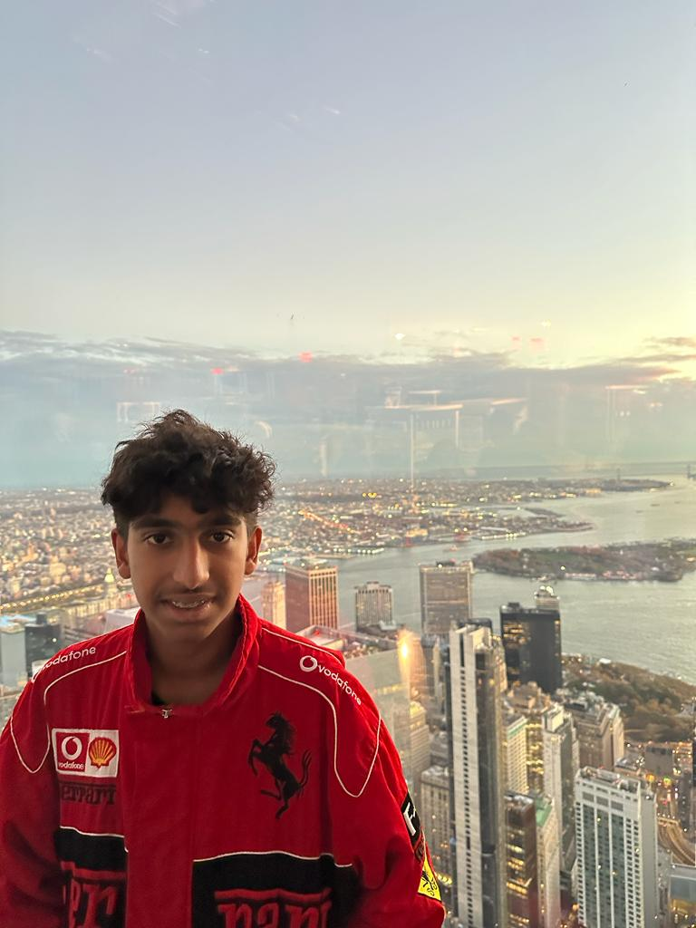
About Me..
My name is Khush Hirani.
I am 16 years old and I study in grade 10.
I live in Kenya.
I like to play football and cricket in school and in my spare time I like helping out my mum in the house chores.

Slide 5
About My Internship with Clevered..
My Intership with clevered has been wonderful although I have encountered callenges the teacher was always there to clear my doubts.
My teacher is called Mani Malhotra and she is from India. Sheis a good teacher and always helped me.

Slide 6
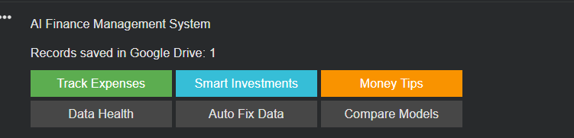
About App..
My project is an AI finance management system whereby it tracks a users income and expenses and advices them on what percentage of their income to spend on.
It also displays smart investment tips for the user to invest in to make a profit.
Next, it also checks the health of the data and shows it in a graph to show the income and expenses and it also fixes the data my replacing the null values.
Lastly, it compares linear regression and polynomial regression to see which one is working better. The project also uses machine learning.

Slide 7
How do I use the App?

Slide 8
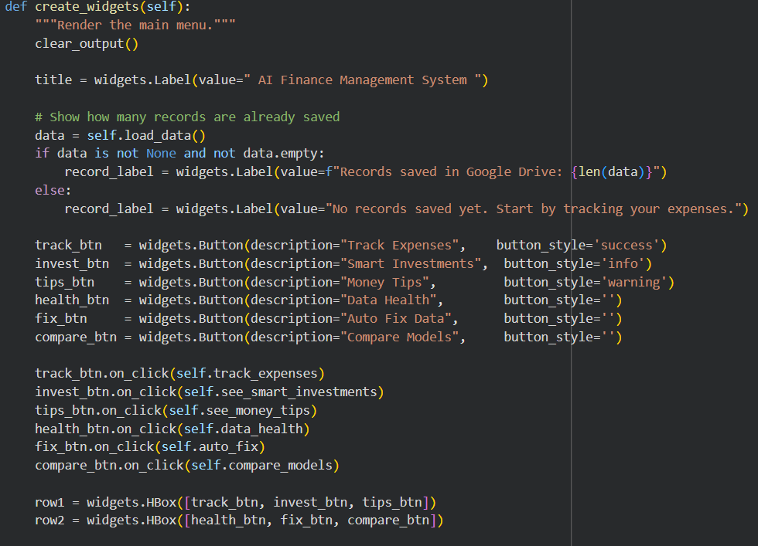
Option Name
(This will be repeated for each option of the App)
Make sure that your intrnet connection is stable for the project to run.
Secondly, you have to enter a minimum od 5 entries before linear and polynomial regression to work .

Slide 9
Contact Person
Please reach out to me on khush6hirani@gmail.com if you have any questions/ concerns/ suggestions on the App

Slide 10
Thank you!

